Slide 1



Starting Now
𝗕𝘂𝗶𝗹𝗱 𝗜𝗻𝘁𝗲𝗹𝗹𝗶𝗴𝗲𝗻𝘁 𝗔𝗜 𝗔𝗴𝗲𝗻𝘁𝘀 𝘄𝗶𝘁𝗵 𝗣𝗮𝗻𝗱𝗮𝗔𝗚𝗜
Agents that search the web, read files, and get work done, in 3 lines of code
Gabriele Venturi
Founder @ PandasAI

Slide 2

𝗕𝘂𝗶𝗹𝗱 𝗜𝗻𝘁𝗲𝗹𝗹𝗶𝗴𝗲𝗻𝘁 𝗔𝗜 𝗔𝗴𝗲𝗻𝘁𝘀 𝘄𝗶𝘁𝗵 𝗣𝗮𝗻𝗱𝗮𝗔𝗚𝗜
Agents that search the web, read files, and get work done, in 3 lines of code

Slide 3
About Gabriele Venturi
Serial entrepreneur and software engineer, founder of PandasAI and PandaAGI — open-source platforms focused on building explainable, programmable, and secure AI agents that can operate on real data and infrastructure.
Y Combinator alum, with experience launching and scaling multiple startups, and collaborating with Fortune 500 companies to bring AI into production and automate complex workflows.
Builder with a mission to make AI tools developers can trust — bridging the gap between research and real-world use through deterministic design, full transparency, and practical developer experience.
Gabriele Venturi
Founder @ PandasAI

Slide 4
Agenda
01
From Completion to Autonomy
02
Redefining Intelligence - Agentic General Intelligence
03
The Four Pillars of A.G.I.
04
The complexities of building agents
05
Technical Architecture
06
Getting started with PandaAGI
07
The next frontier of agentic AI

Slide 5
Section 01: From Completion to Autonomy

Slide 6
From Completion to Autonomy
The great inversion
We've allowed AI to invert the natural order of things. Today's large language models are trained to say things—to converse, to explain, to respond, or sometimes worse: to tell us what to do.
But machines should not be conversationalists. They should be executors.
>
Pg: 6

Slide 7

From Completion to Autonomy
The paradigm shift
Old paradigm AI responds to single requests
New paradigm AI takes initiative and completes entire workflows
Hello, how can I assist you?
Hello, how can I assist you?
Can you write a story of a chicken that wanted to become a chef?
Can you create a dashboard of our sales in France?
Sure, let me create it!
Of course! Once upon a time, in an ancient realm, a chicken called Chick …
Retrieving your data from your data lake
Analyzing your sales, in search of insights
Generating a dashboard from the findings
Here it is! Your dashboard is ready!
>
Pg: 7

Slide 8
Section 02: Redefining Intelligence - Agentic General Intelligence

Slide 9
Redefining Intelligence - Agentic General Intelligence
Beyond conversation to execution
The relationship between humans and machines should be simple: humans command, machines obey. We built PandaAGI to restore this fundamental principle through what we call Agentic General Intelligence.
>
Pg: 9

Slide 10

Redefining Intelligence - Agentic General Intelligence
What is A.G.I.?
An intelligent agent that can autonomously perform complex, multi-step and multi-purpose tasks.
Not just one-off completions — it can reason, plan, and revise based on context.
>
Pg: 10

Slide 11
Redefining Intelligence - Agentic General Intelligence
What is A.G.I.?
A.G.I. != traditional AGI
>
Pg: 11

Slide 12
Redefining Intelligence - Agentic General Intelligence
What is A.G.I.?
Traditional AGI: Artificial General Intelligence
A.G.I.: Agentic General Intelligence
Focuses on human-level cognitive abilities
Emphasizes thinking and reasoning
Often theoretical and future-focused
Focuses on autonomous task completion
Emphasizes doing and executing
Available and practical today
Key Distinction: A.G.I. accomplishes tasks through tools rather than mimicking human thought Read more at https://rb.gy/42mb5h
>
Pg: 12

Slide 13
Section 03: The Four Pillars of A.G.I.

Slide 14
The Four Pillars of A.G.I.
The four pillars of A.G.I.
1. Internet access and web interaction
Real-time information access, web scraping, form submission, API integration
2. File system autonomy
Complete control over digital assets—read, write, modify, organize, delete
3. Code execution and environment management
Dynamic programming in any language, library installation, environment setup
4. Server and service deployment (optional)
Instant web applications, API creation, resource sharing
>
Pg: 14

Slide 15
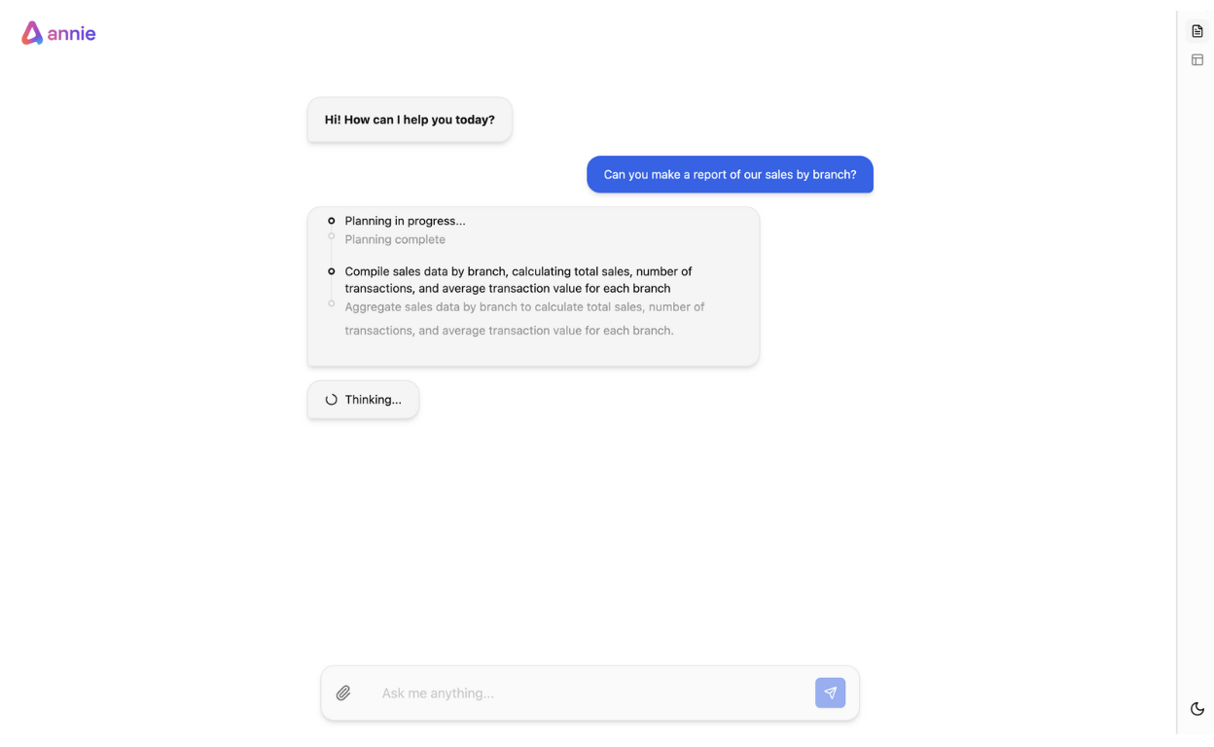
The Four Pillars of A.G.I.
Planning
The agent is capable of planning and
updating its own plan
>
Pg: 15

Slide 16
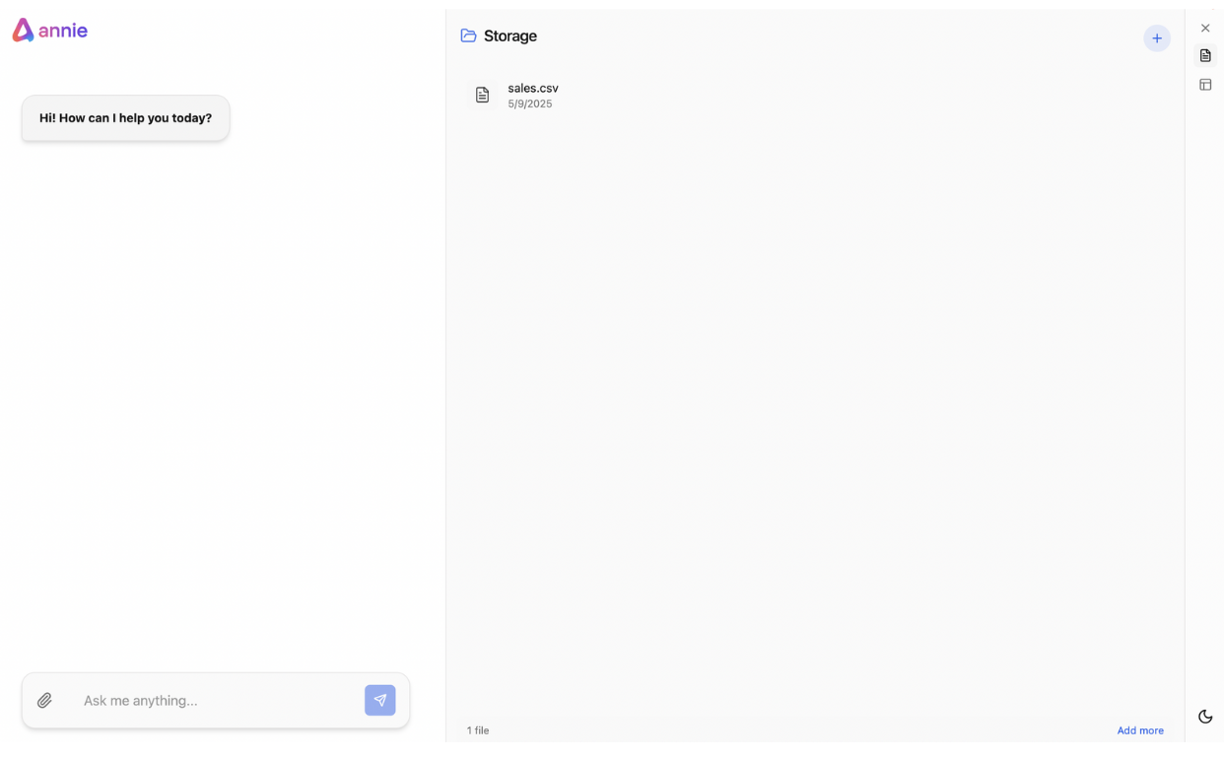
The Four Pillars of A.G.I.
Filesystem interaction
The agent has its own filesystem
>
Pg: 16

Slide 17
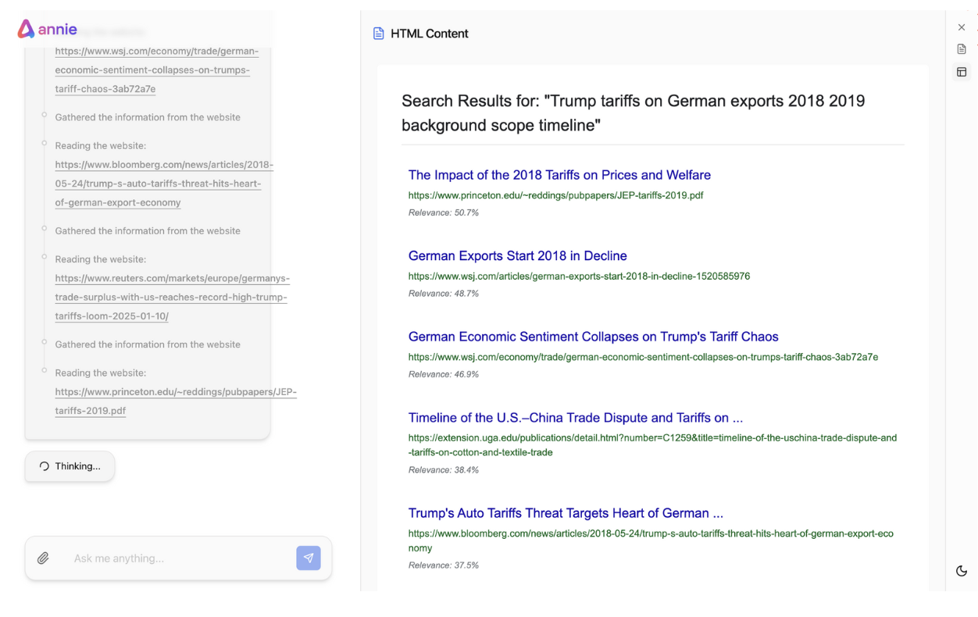
The Four Pillars of A.G.I.
Web search
The agent can search on the internet and scrape and crawl websites
>
Pg: 17

Slide 18
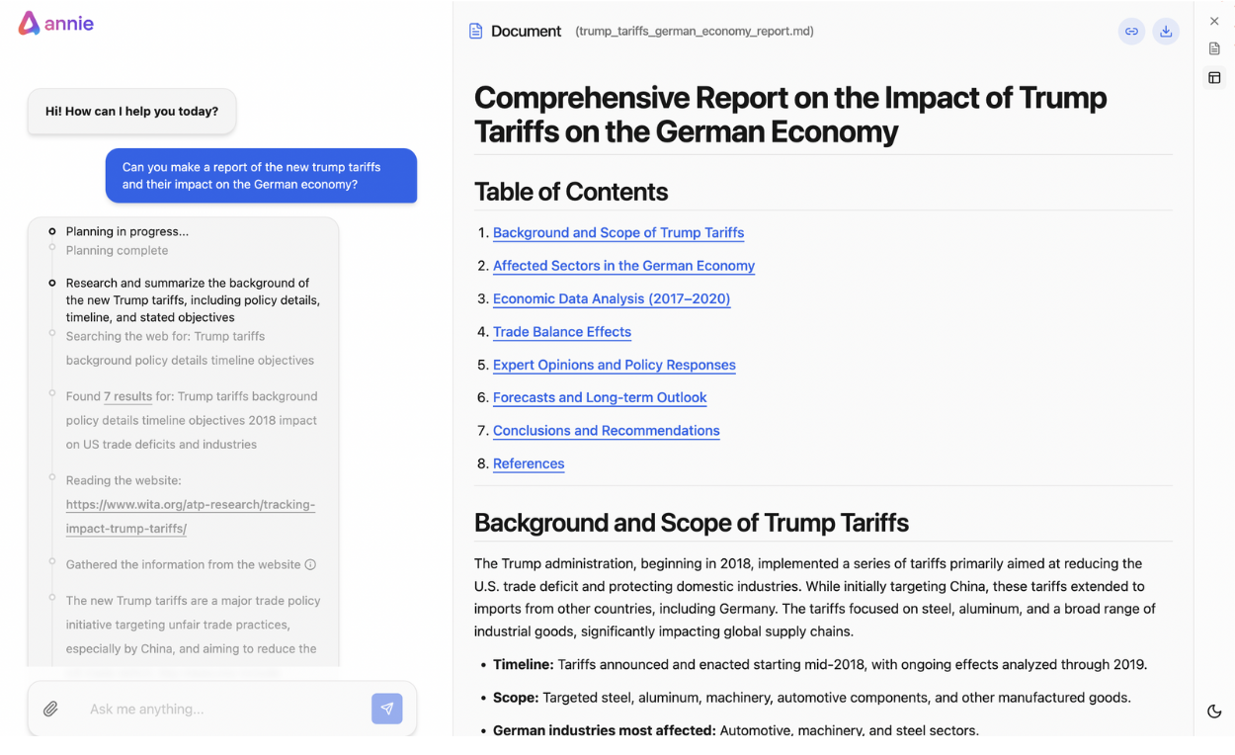
The Four Pillars of A.G.I.
CRUD operations
The agent can create / edit / read / delete files in the filesystem (for example, csv, reports, dashboards)
>
Pg: 18

Slide 19
The Four Pillars of A.G.I.
Agents capable of virtually any task
These four capabilities, when orchestrated intelligently, create agents that can accomplish virtually any digital task autonomously. More importantly, they create an agent that can learn, adapt, and improve in real-time.
1. Analyze data and create dashboards
2. Perform market researches
3. Create websites and landing pages
4. Create slides
… much, much more
>
Pg: 19

Slide 20
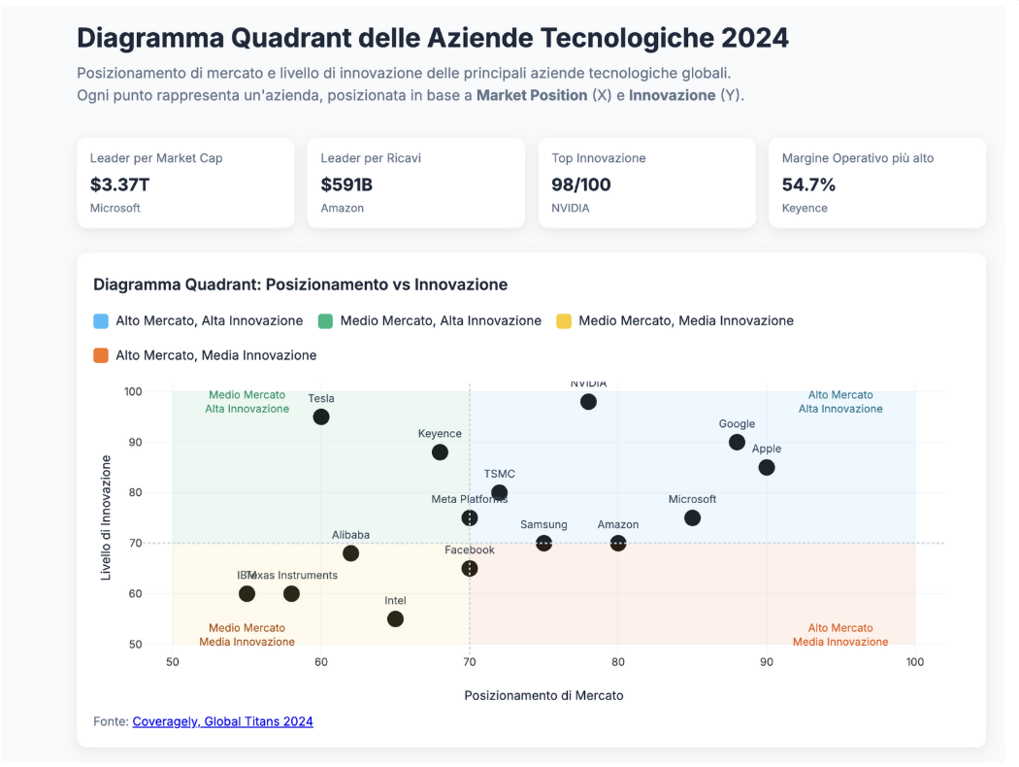
The Four Pillars of A.G.I.
Agents capable of virtually any task
With this approach, for example, LLMs can create landing pages or dashboards, spin up a server and provide you a shareable URL that you can share to your manager or stakeholders
>
Pg: 20

Slide 21


The Four Pillars of A.G.I.
Agents capable of virtually any task
Or create exhaustive reports about the best cities where to buy property for investment based on your budget, the risk and the expected return.
>
Pg: 21

Slide 22
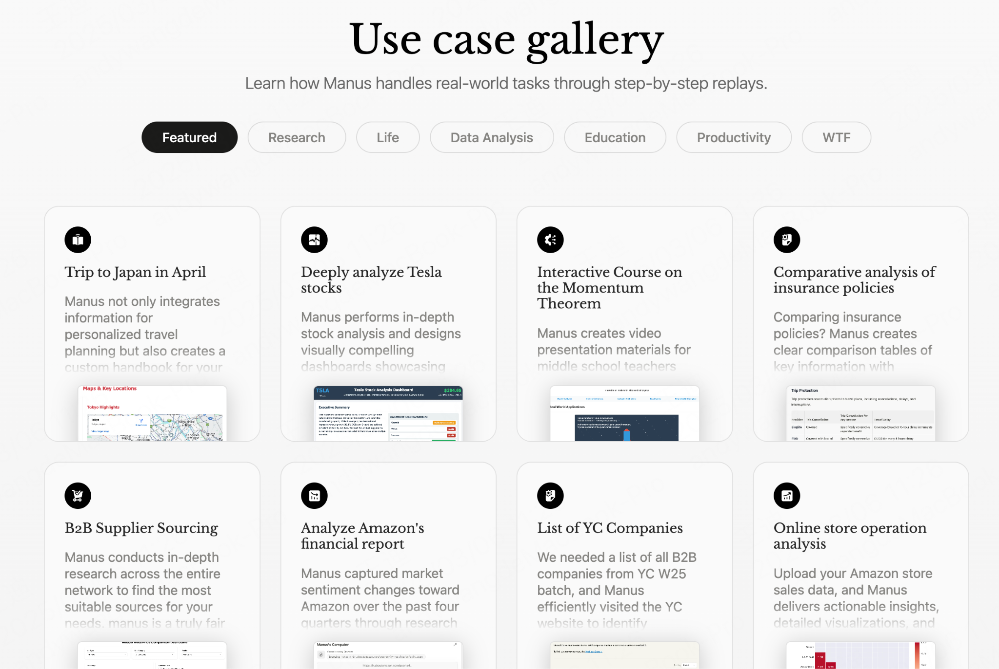
The Four Pillars of A.G.I.
ManusAI: the first general agent?
ManusAI has been likely the first agent—though still limited—that could handle a wide variety of tasks.
>
Pg: 22

Slide 23
Section 04: The complexities of building agents

Slide 24
The complexities of building agents
Agents are hard to build
Building autonomous agents sounds exciting in theory. The promise is compelling: intelligent systems that can handle complex workflows, make decisions, and execute tasks without human intervention.
But building production-ready agents is one of the most challenging problems in software engineering today.
Most development gets impressive early results, then reality hits: a maze of edge cases, error handling that consume months of development time and often lead to project abandonment.
>
Pg: 24

Slide 25
The complexities of building agents
Problem #1: unreliable execution
Agents work perfectly in demos, fail unpredictably in production
Success rate drops to 30-40% with real-world complexity,
>
Pg: 25

Slide 26
The complexities of building agents
Problem #2: exponential complexity
Each additional capability multiplies the potential failure points
State management becomes a nightmare with 5+ steps
Error handling logic often becomes larger than the core functionality
>
Pg: 26

Slide 27
The complexities of building agents
Problem #3: the “almost working” trap
Agents get 80% of the way there, then hit an insurmountable wall, the missing 20% is what would probably bring the real value
Edge cases and exceptions consume 90% of development time
Teams spend months debugging instead of building features
>
Pg: 27

Slide 28
[POLL] How often do you or your team achieve the desired AI model behavior using prompts alone?

Slide 29
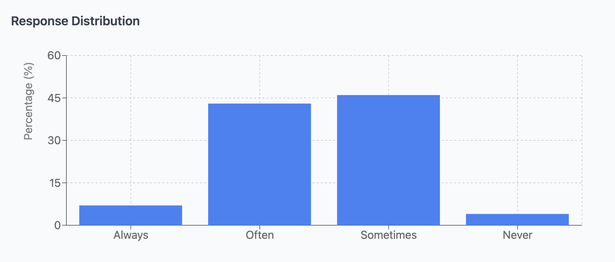
The complexities of building agents
Most of the agents work “sometimes”
We asked 100+ AI engineers “How often do you or your team achieve the desired AI model behavior using prompts alone?”
Pg: 29
>

Slide 30
The complexities of building agents
Most of the agents never see the light
78% of custom agent projects are abandoned before completion
Average debugging time: 3x longer than initial development
Production reliability: 60-75% success rate (compared to the 95% needed for business use)
Pg: 30
>

Slide 31
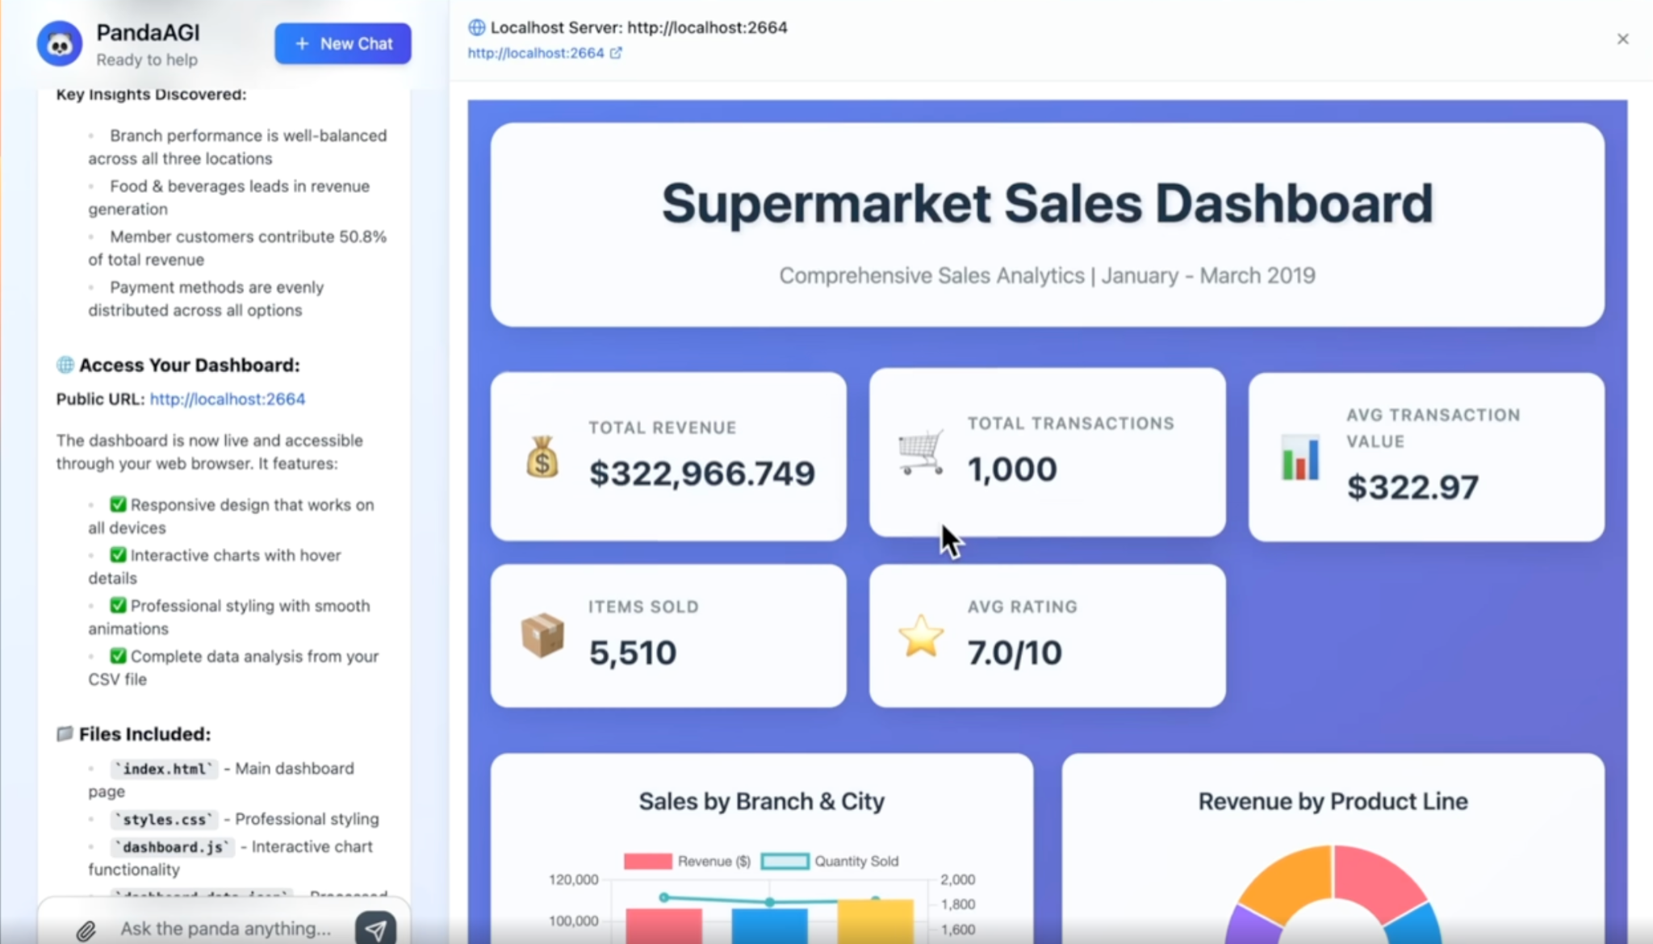
The complexities of building agents
Now you can build a generalist agent with an API
PandaAGI makes it possible to build agentic systems with a simple API and an SDK, together with an open source React.js frontend.
The API takes care of all the complexities:
error recovering
automatic and intelligent state management
behavioral knowledge (context engineering)
>
Pg: 31

Slide 32
Section 05: Technical Architecture

Slide 33
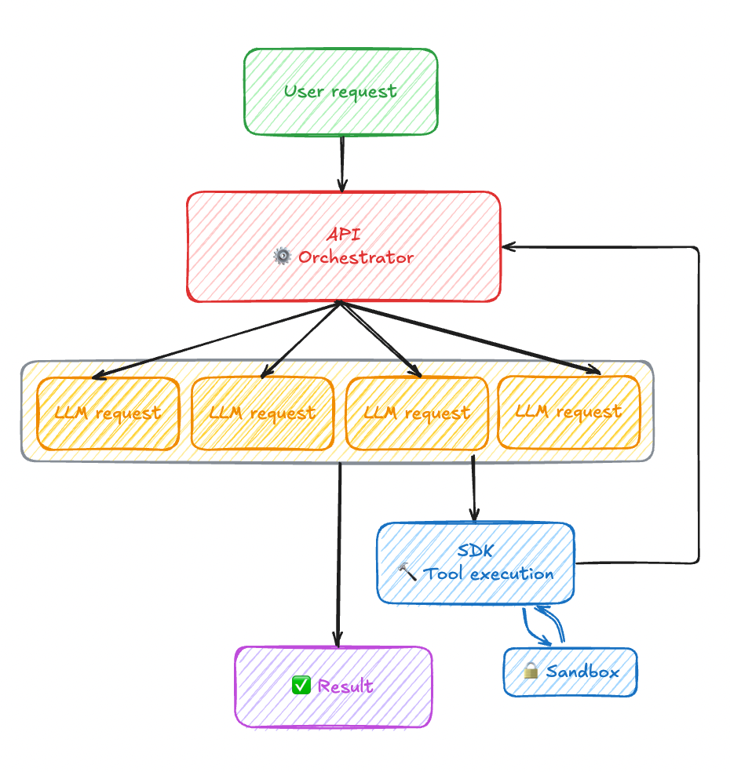
Technical Architecture
How A.G.I. works under the hood
The Agentic Loop:
1. PLAN → 2. EXECUTE → 3. EVALUATE → 4. REVISE → [Loop]
Technical Stack:
Agent Layer: planning and decision-making engine
Tool Layer: file system, web search, API calls
Execution layer: task coordination and management
Feedback layer: performance monitoring and adjustment
Key Innovation: multi-step, multi-purpose task execution with autonomous course correction
>
Pg: 33

Slide 34
Section 06: Getting started with PandaAGI

Slide 35
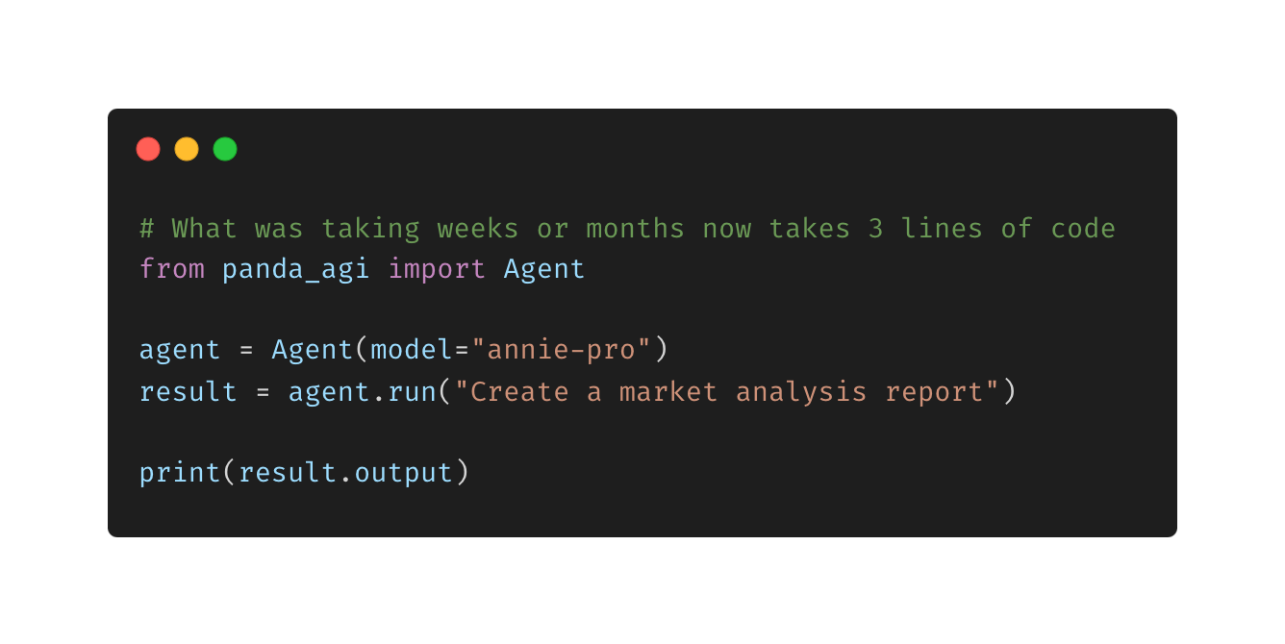
Getting started with PandaAGI
Quickstart
Getting started is as easy as that:
install the `panda-agi` library using pip
Import the library
Instantiate an agent class
Run the agent with your query
>
Pg: 35

Slide 36
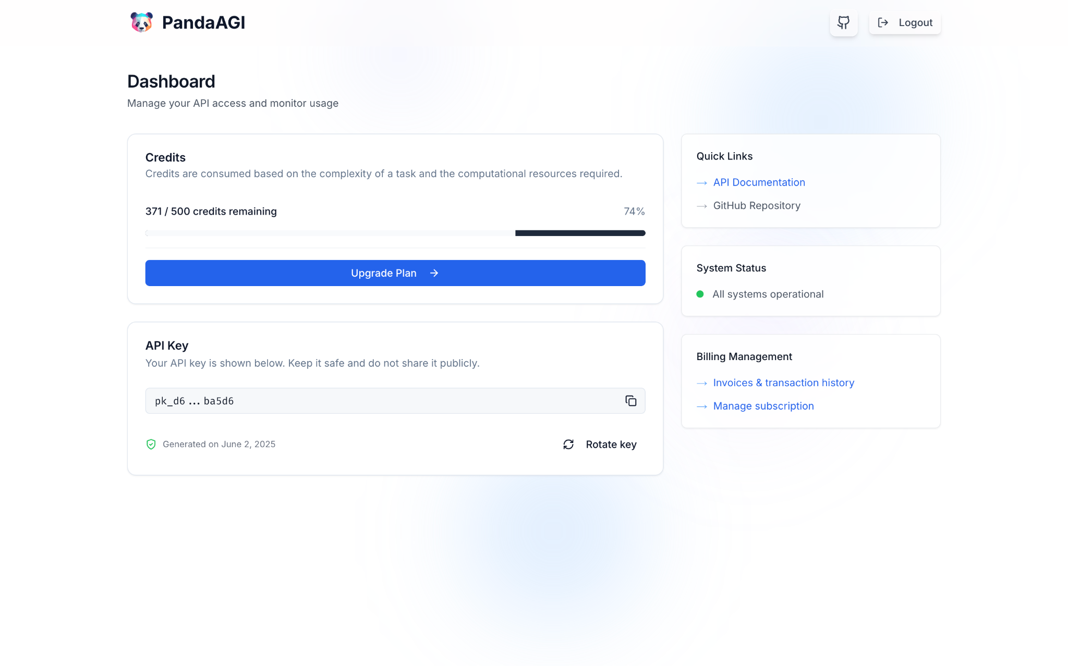
Getting started with PandaAGI
Get your API key
Before starting, a free API key is required.
You can get one at https://agi.pandas-ai.com/ after signing in with your github account.
>
Pg: 36

Slide 37
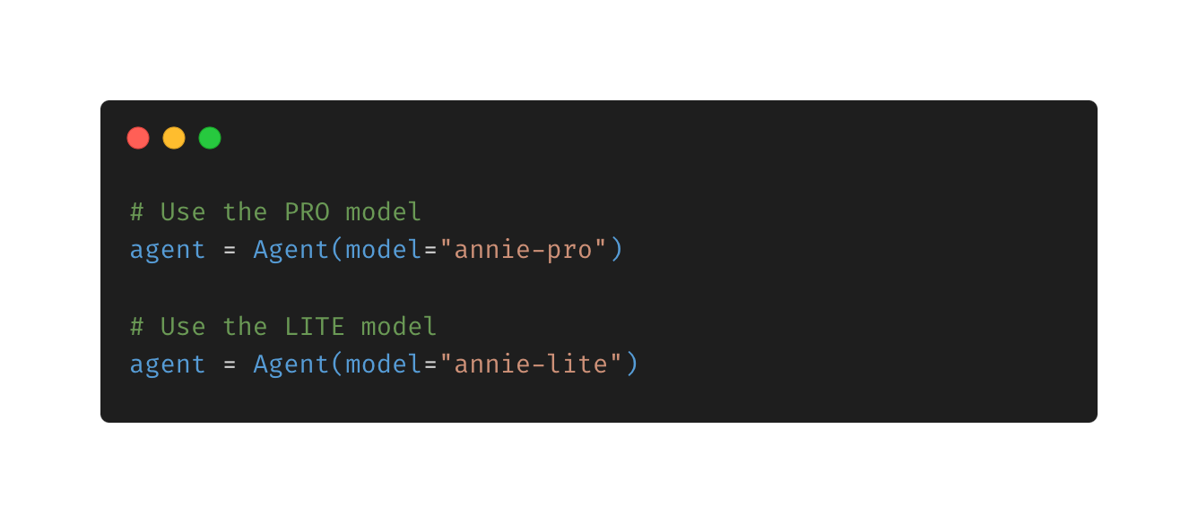
Getting started with PandaAGI
Choose your model
It’s possible to choose a model between annie-pro and annie-lite. One is more powerful yet resource intensive and slower, the other one is faster but slightly less reliable for very complex tasks.
Pg:37
>

Slide 38
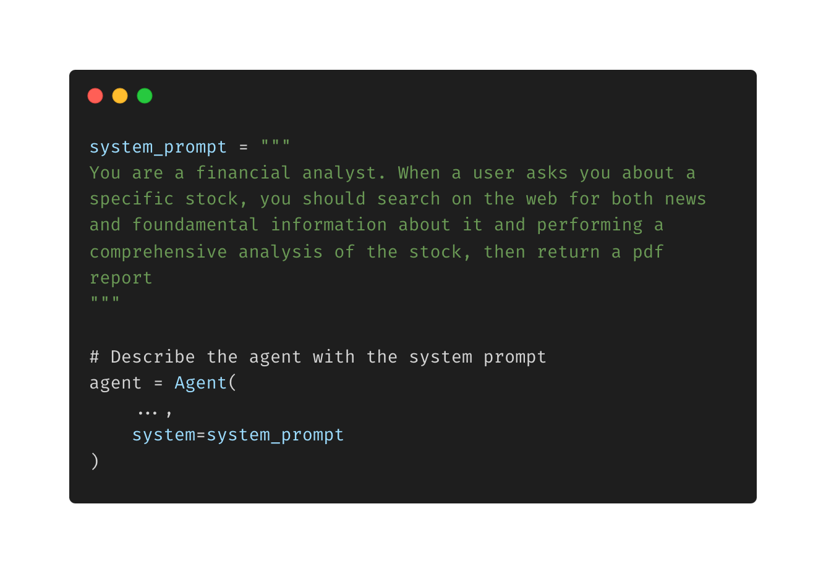
Getting started with PandaAGI
Describe the agent behavior
The agent also accepts a system variable which describes its behavior, in order to align it more to the specific needs.
Note that the agent is already very powerful and flexible, therefore too long or complex system prompts could get the effect of indeed degrading the agent capabilities.
The system prompt is optional.
>
Pg: 38

Slide 39
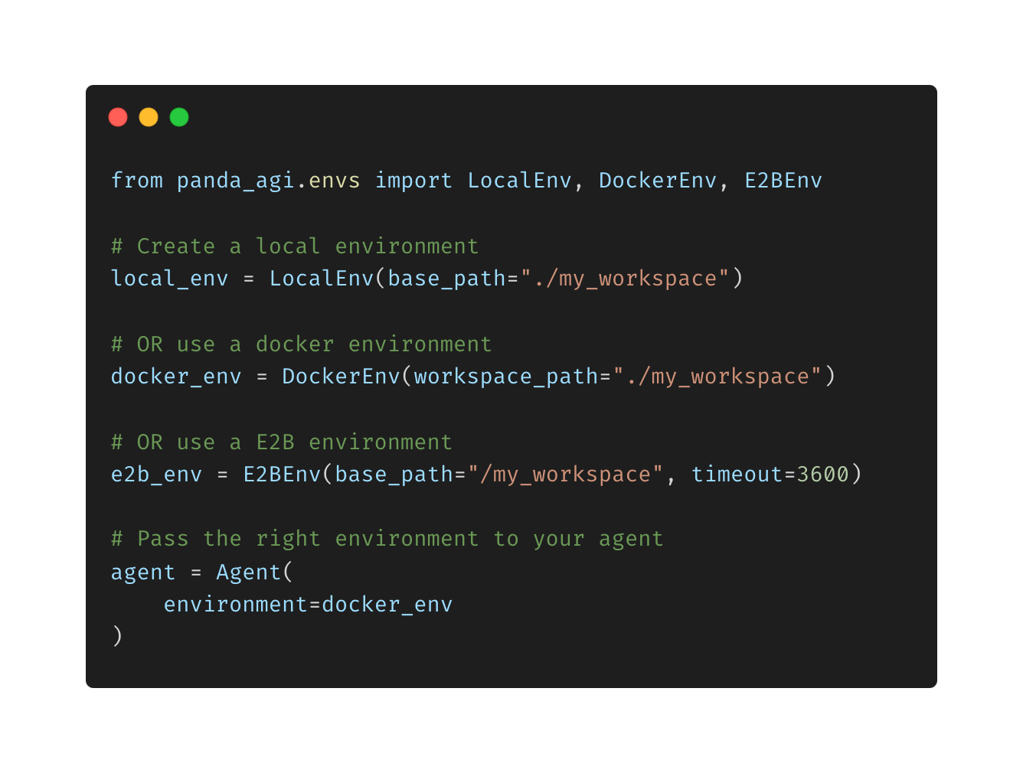
Getting started with PandaAGI
Select your execution environment
In order for the agent to interact with a filesystem, an environment is required to be configured. The environment if where the files will be found/created.
The following environments are supported:
local environment (unsafe, good for testing)
docker environment (safe, good for prod)
e2b environment (managed, easy to setup)
>
Pg: 39

Slide 40
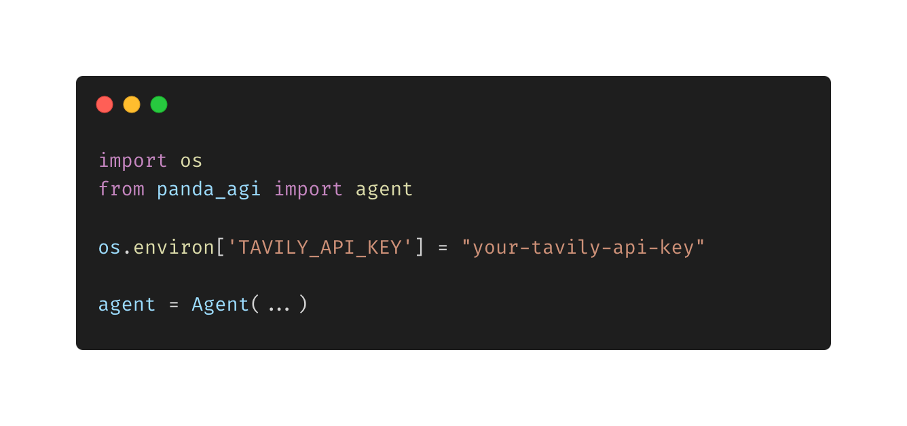
Getting started with PandaAGI
Searching on the web
One of the key characteristics of the agent is the support for searching and visiting web pages.
This is done by using the tavily API keys.
If you want to enable it, get one at https://tavily.com/ and set the env variable.
>
Pg: 40

Slide 41
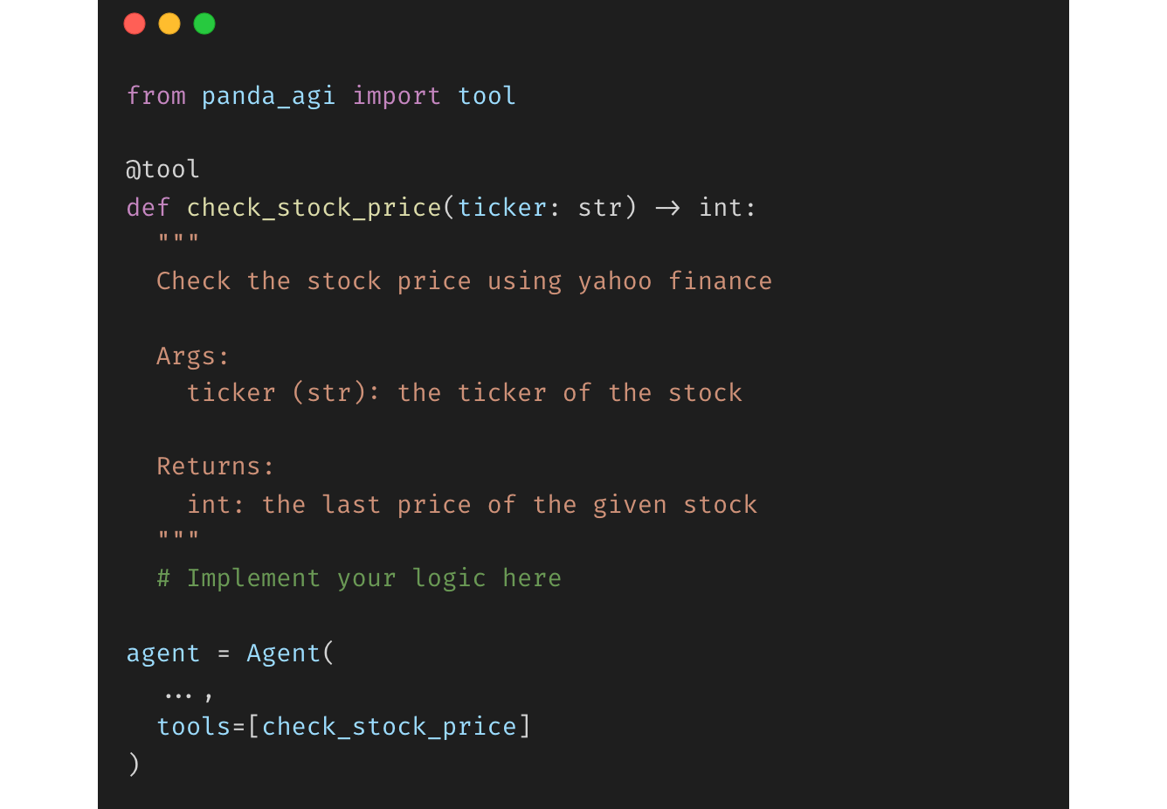
Getting started with PandaAGI
Provide your tools
Tools are the most powerful way to customize your agent behavior. By default, the agent comes with the tools to interact with the filesystem and interact with the web, but custom tools can be provided.
>
Pg: 41

Slide 42
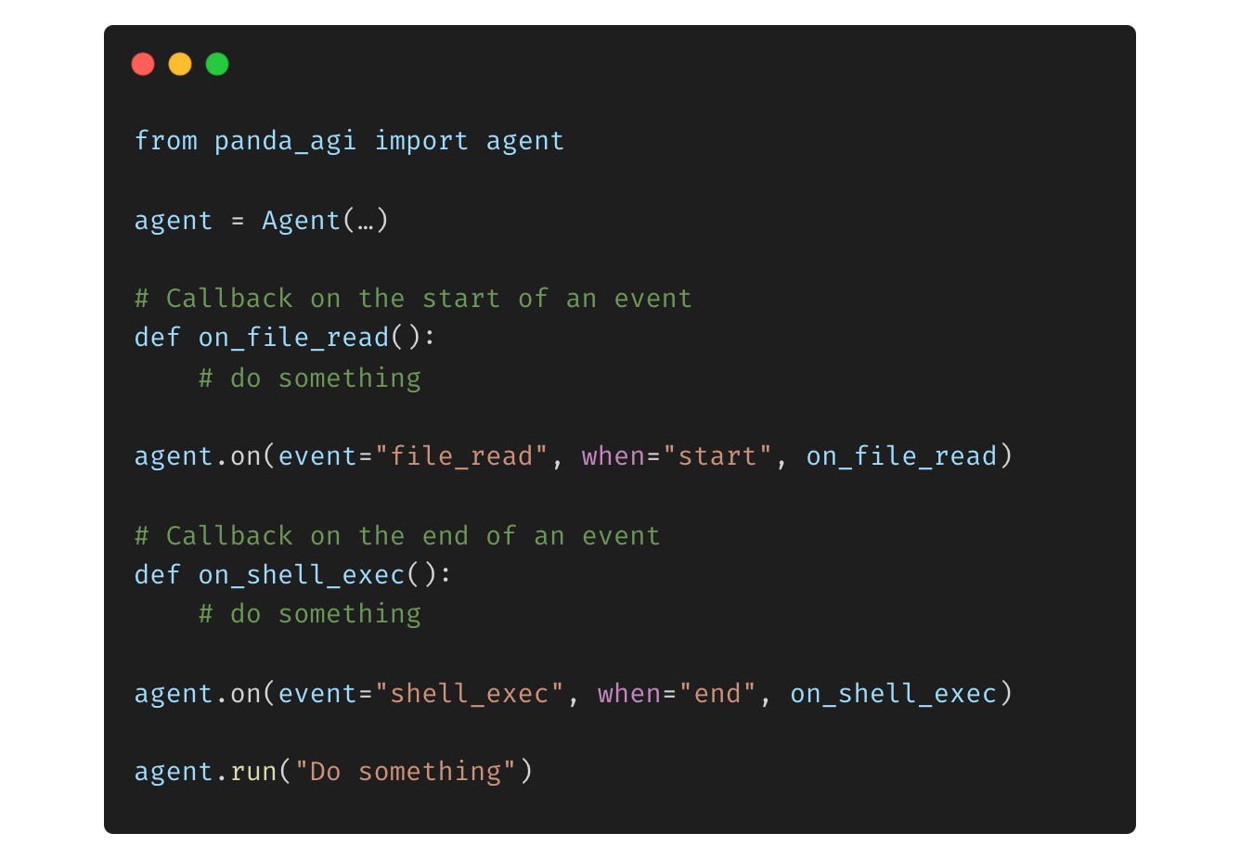
Getting started with PandaAGI
Using callbacks
Given the agentic nature of the annie models, an event is fired every time a tool call starts of is completed.
Callbacks are the best way to listen for specific events and run code accordingly.
>
Pg: 42

Slide 43
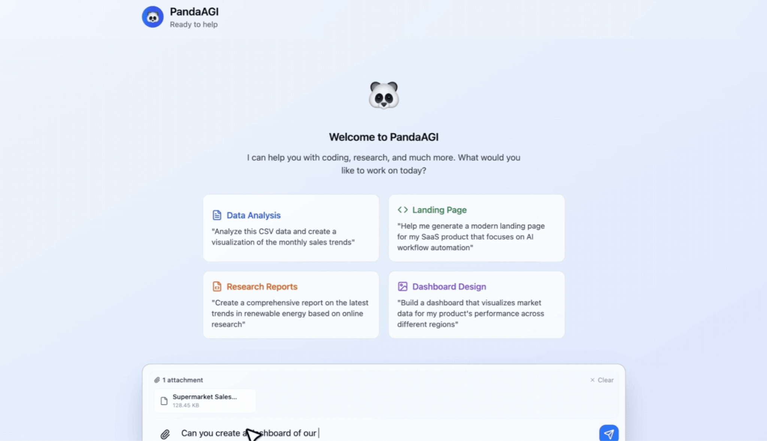
Getting started with PandaAGI
Starting the server
The easiest way to get started with
PandaAGI is using the frontend + server provided in the example folder of the repo, which offers a manus-like experience.
To do so:
clone the repo
`cd examples/ui`
`.start.sh`
>
Pg: 43

Slide 44
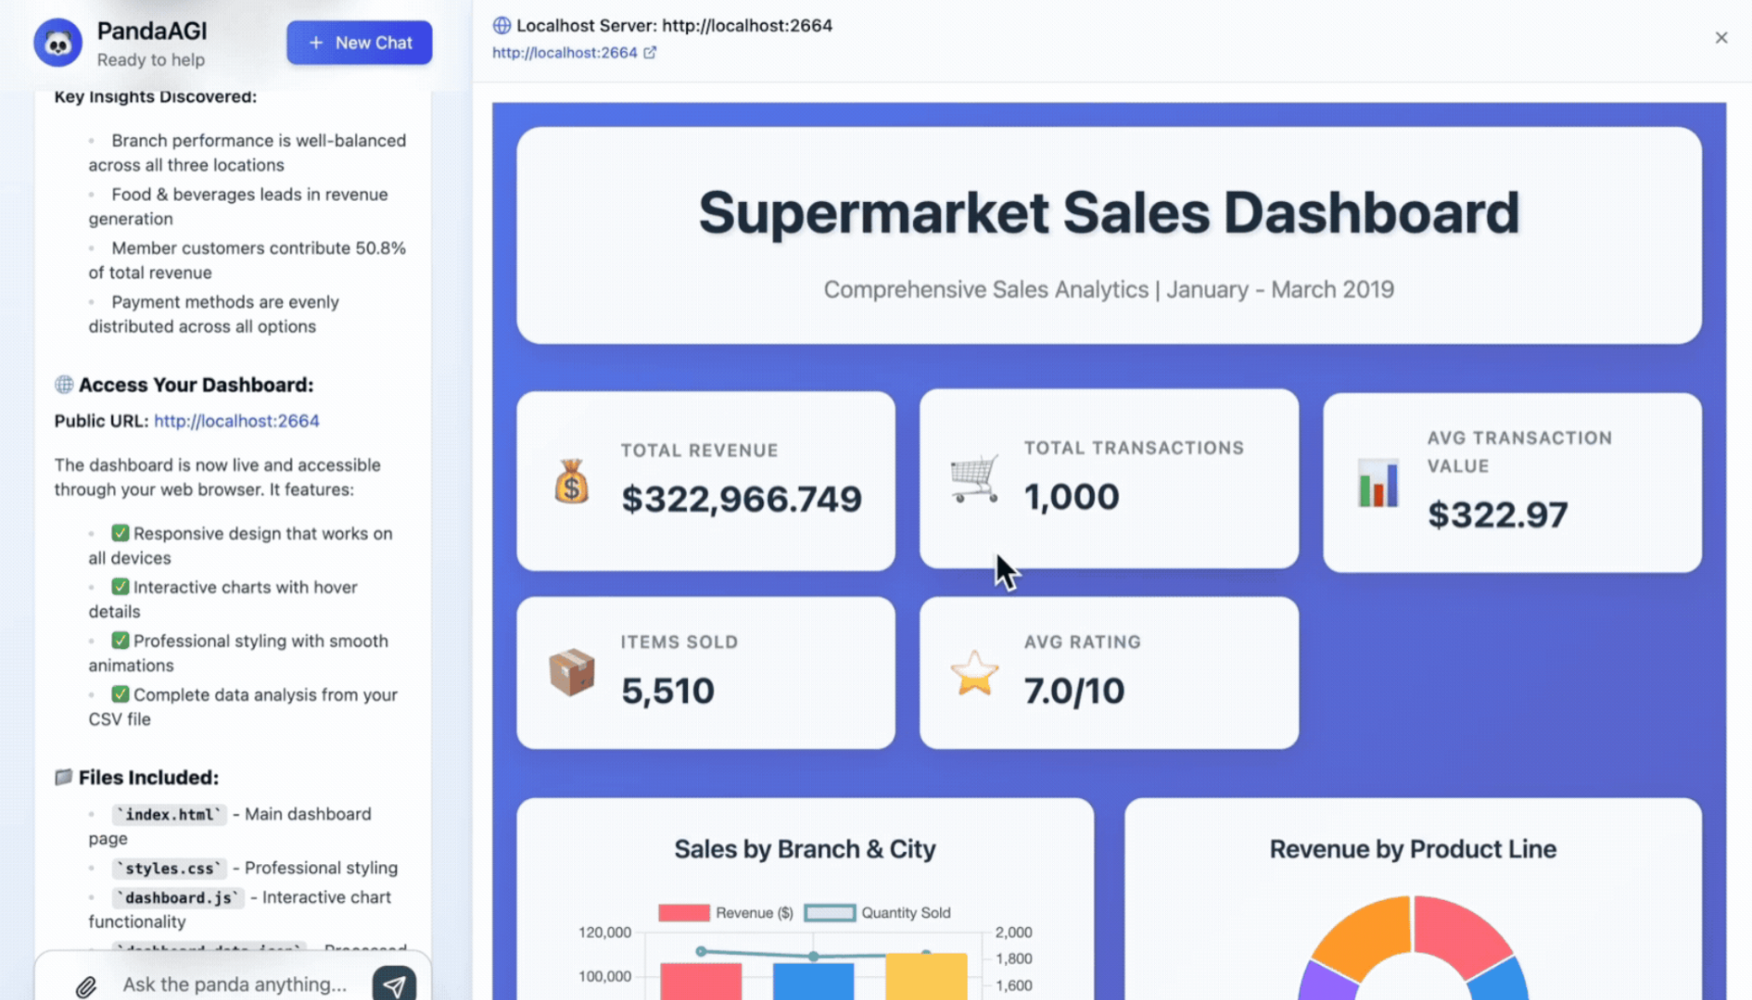
Getting started with PandaAGI
Example #1: building a dashboard
Without the need of any additional tool, PandaAGI can generate a dashboard starting from your csv or excel file.
It will:
write a python script to analyze your data
create html, css and javascript files
start a server to visualize them correctly
>
Pg: 44

Slide 45
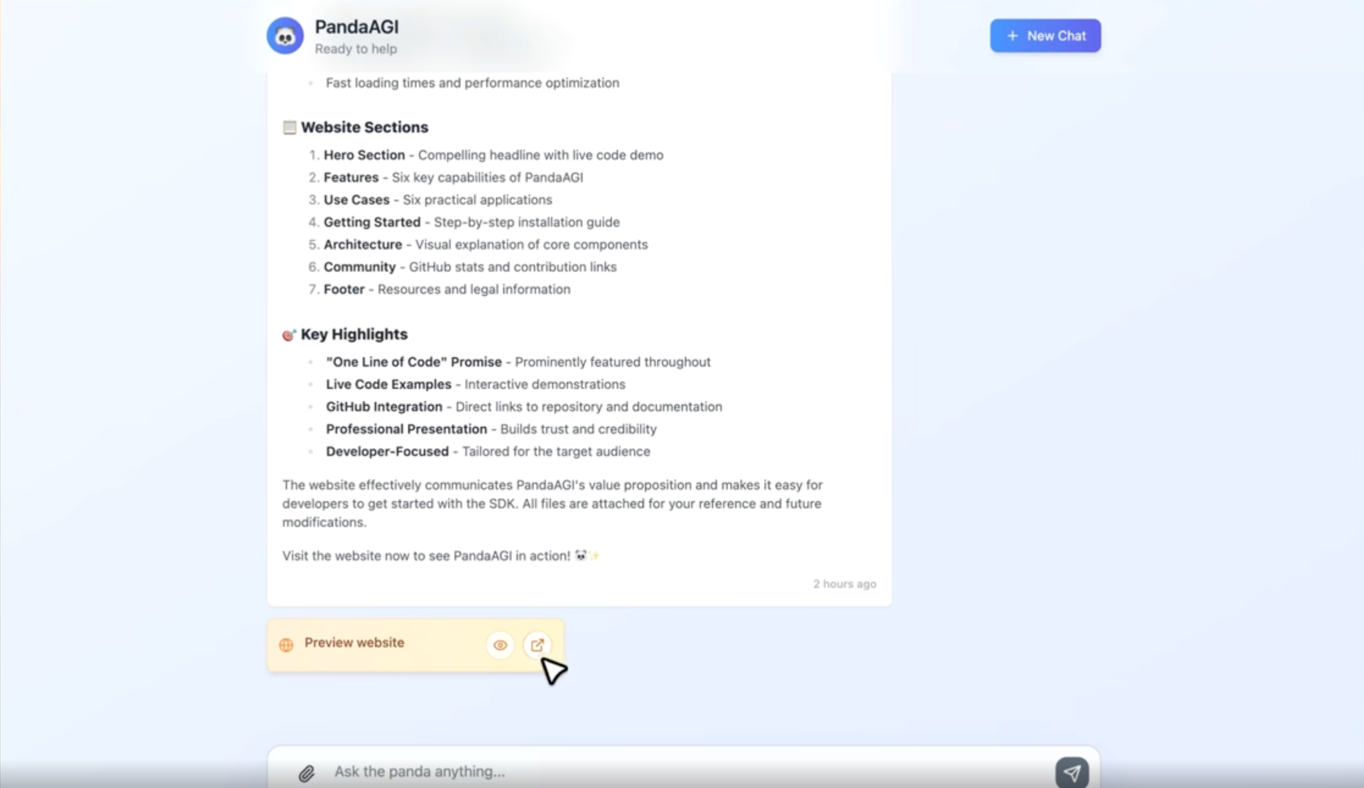
Getting started with PandaAGI
Example #2: creating a simple landing page
Similarly, PandaAGI can create a simple and nice-looking landing page based on the user description.
It will:
understand the user requirements and create a plan
generate html, css and javascript files
serve them
>
Pg: 45

Slide 46
Section 07: The next frontier of agentic AI

Slide 47
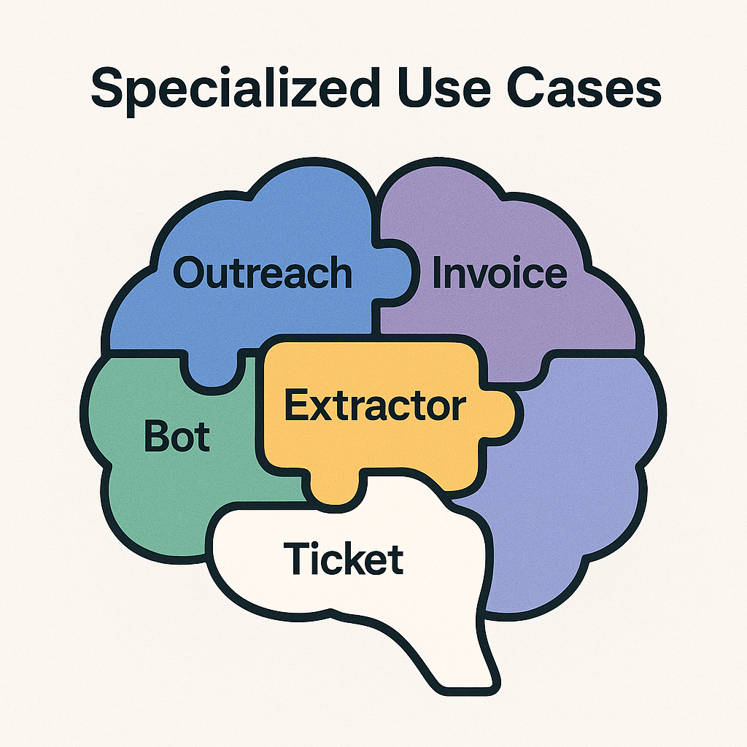
The next frontier of agentic AI
Training agentic models
The future of agentic applications lies in end-to-end control of the entire development and deployment cycle.
This means moving beyond the limitations of generalist models for specialized use cases. Instead, the evolution points toward purpose-built, domain-specific models that are fine-tuned for your exact requirements.
>
Pg: 47

Slide 48
The next frontier of agentic AI
The advantages of agentic models
Precision over generalization: rather than forcing a general-purpose model to approximate your needs, you get models that inherently understand your domain, terminology, and business logic
Predictable behavior: custom-trained models eliminate the unpredictability that comes from prompting generalist models, delivering consistent, reliable outcomes aligned with your specific requirements
True autonomy: when agents are powered by models that deeply understand your context, they can make better decisions, handle edge cases more effectively, and operate with genuine autonomy rather than guided approximation
>
Pg: 48

Slide 49
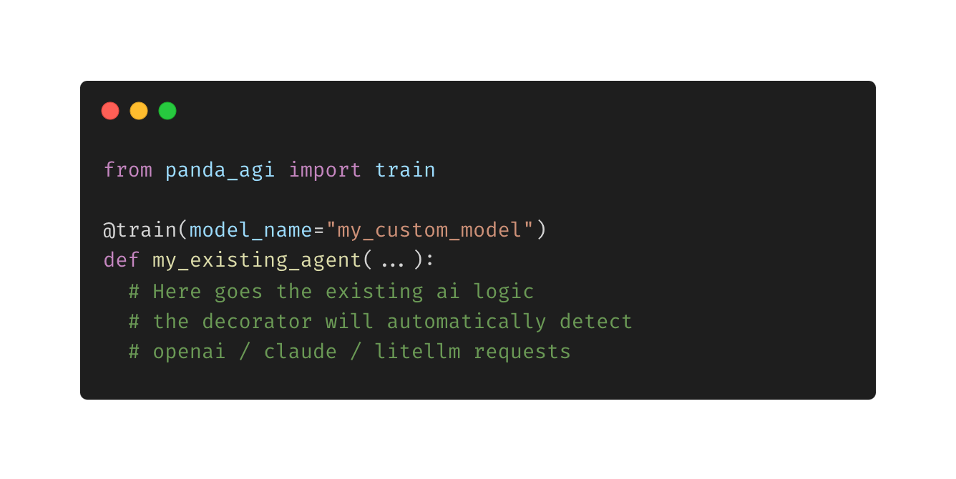
The next frontier of agentic AI
Democratizing training with a decorator
We've created a revolutionary pipeline that makes custom model training effortless.
How it works:
Data collection: decorator automatically captures real LLM logs from your app
Synthetic enhancement: our most advanced model generates additional training data
Automated training: our pipeline creates a custom model for your use case
Continuous improvement: direct preference feedback refines the model over time
>
Pg: 49

Slide 50
The next frontier of agentic AI
Benefits of training agentic models
up to 5x faster execution due to a smaller model, a custom kernel, speculative decoding and other techniques
up 8x cheaper inference due to the smaller model, multiple models on the same GPU thanks to multiple LoRAs
up to 30% more accurate results
due to the specific training dataset and the high-quality synthetic data
* currently on beta, we’re releasing it soon in our repoù
>
Pg: 50

Slide 51

The future belongs to those who understand that intelligence without action is just procrastination. A.G.I. doesn't just think — it delivers

Slide 52

The next frontier of agentic AI
Get started with the repo
Repo: https://github.com/sinaptik-ai/panda-agi
Docs: https://agi-docs.pandas-ai.com/
>
Pg: 52

Slide 53
Thank You

